Slide 1
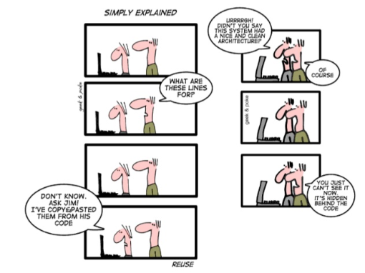
What is Clean Code?
https://www.youtube.com/watch?v=7EmboKQH8lM

Slide 2
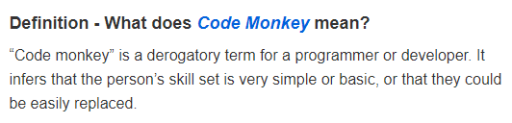
What is Clean Code?
https://www.computerweekly.com/feature/Are-you-a-professional-or-just-a-code-monkey
"Most IS managers I have worked for have had limited understanding of technical issues on which they make decisions.
The good ones realize this and respect the technical opinion and professionalism of the people who work for them. The bad ones ignore advice, often with dire consequences."
"People who are good technical professionals often have no aspirations to become managers - something that others seem unable to comprehend."
"Programmers work with a mind-set that is totally different from that of managers, and the professionalism that this mind-set develops is as valuable as their technical skill," he says.

Slide 3
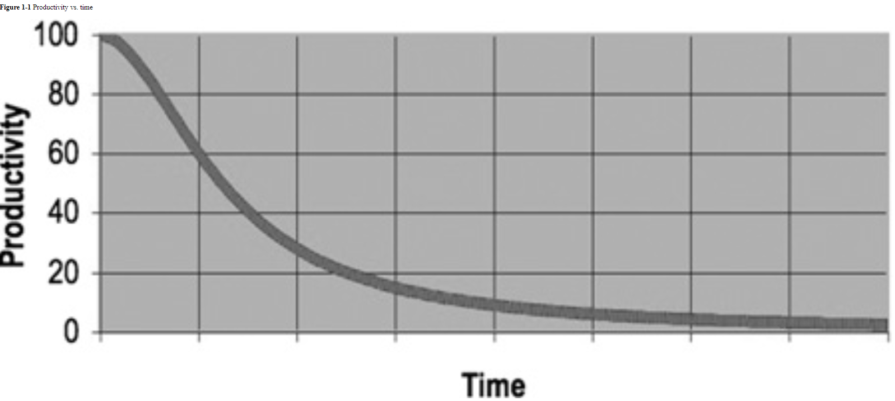
952011
Team productivity is often impacted by:
How long the code has been around
The volume of changes to the code
Eventually Team rebels -> Demands redesign
Have to build new product while supporting the old
Often changes continue to the old

Slide 4
When do you go to management?
Most managers want the truth, even when they don’t act like it. Most managers want good code, even when they are obsessing about the schedule.
The Clean Code Conundrum
Most experienced developers know that code slop slow things
BUT pressure to make messes in order to meet deadlines.
Experienced code sense
rookie or no “code-sense” => look at a messy module and recognize the mess but will have no idea what to do about it.
“code-sense” will look at a messy module and see options and variations.

Slide 5
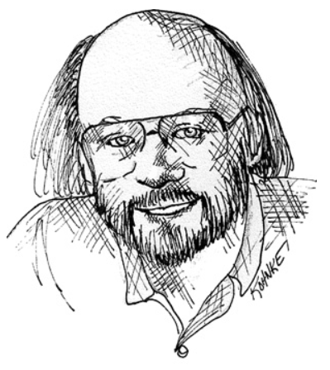
What is Clean Code
I like my code to be elegant and efficient. The logic should be straightforward to make it hard for bugs to hide, the dependencies minimal to ease maintenance, error handling complete according to an articulated strategy, and performance close to optimal so as not to tempt people to make the code messy with unprincipled optimizations. Clean code does one thing well.
Bjarne Stroustrup, inventor of C++ and author of The C++ Programming Language

Slide 6
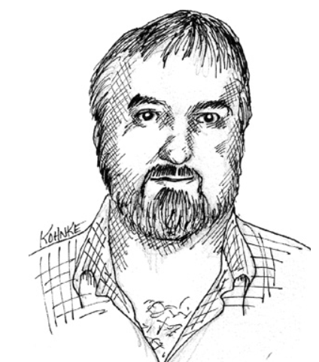
What is clean code
I could list all of the qualities that I notice in clean code, but there is one overarching quality that leads to all of them. Clean code always looks like it was written by someone who cares. There is nothing obvious that you can do to make it better. All of those things were thought about by the code’s author, and if you try to imagine improvements, you’re led back to where you are, sitting in appreciation of the code someone left for you—code left by someone who cares deeply about the craft.
Michael Feathers, author of Working Effectively with Legacy Code

Slide 7
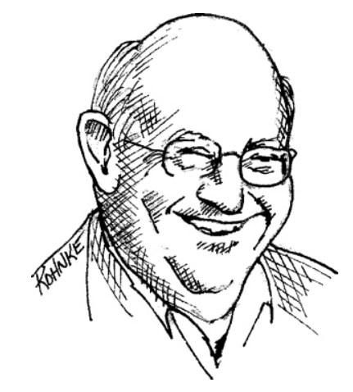
What is Clean Code
“Big” Dave Thomas, founder of OTI, godfather of the Eclipse strategy
Clean code can be read, and enhanced by a developer other than its original author. It has unit and acceptance tests. It has meaningful names. It provides one way rather than many ways for doing one thing. It has minimal dependencies, which are explicitly defined, and provides a clear and minimal API. Code should be literate since depending on the language, not all necessary information can be expressed clearly in code alone.
readability for other developers

Slide 8
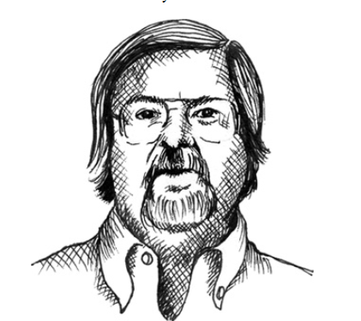
Ron Jeffries, author of Extreme Programming Installed and Extreme Programming Adventures in C#
In priority order, simple code:
• Runs all the tests;
• Contains no duplication;
• Expresses all the design ideas that are in the system;
• Minimizes the number of entities such as classes, methods, functions, and the like.
Of these, I focus mostly on duplication. When the same thing is done over and over, it’s a sign that there is an idea in our mind that is not well represented in the code. I try to figure out what it is. Then I try to express that idea more clearly

Slide 9
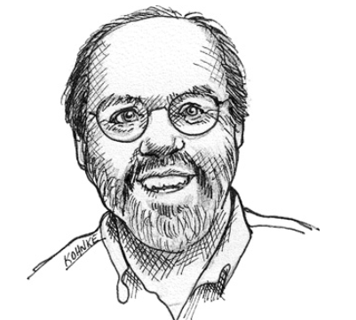
Ward Cunningham, inventor of Wiki, inventor of Fit, coinventor of eXtreme Programming. Motive force behind Design Patterns. Smalltalk and OO thought leader. The godfather of all those who care about code.
You know you are working on clean code when each routine you read turns out to be pretty much what you expected.
You can call it beautiful code when the code also makes it look like the language was made for the problem.
Read the code and its about what you expect it to be. AKA no surprises or unnatural puzzles.
. He says that beautiful code makes the language look like it was made for the problem! So it’s our responsibility to make the language look simple

Slide 10

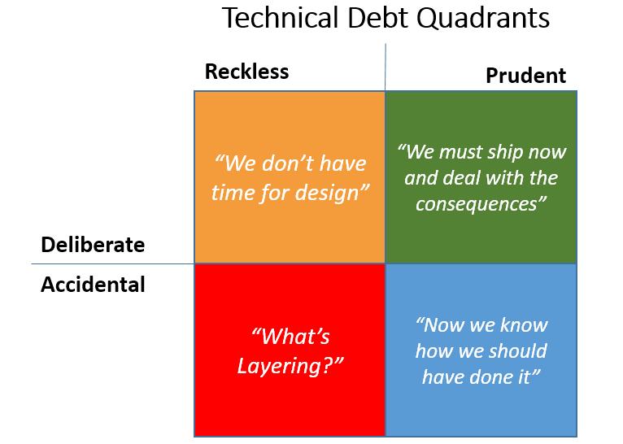

Rule #1 The Boy Scout Rule and technical debt
AKA Technical debt -> a metaphor for shortcuts, hacks and poor design choices… sooner or later … it must be paid back
https://deviq.com/technical-debt/
The act of leaving a mess in the code should be as socially unacceptable as littering. — Robert C. “Uncle Bob” Martin

Slide 11
According to https://hackernoon.com/there-are-3-main-types-of-technical-debt-heres-how-to-manage-them-4a3328a4c50c
1. Deliberate tech debt – Sometimes needed to make a schedule
- You know there is a right way to do it, but schedule drives compromise.
Usually track in the backlog
Often product owners and stakeholders accountable for this debt.
2. Accidental/outdated design tech debt
- Requirements evolve, design choices may become a problem.
Significant refactoring needs to happen from time to time
PO and Team leads accountable for this debt.
- Should avoid this debt by understanding and refactoring
Lots of incremental changes causes Code slowly devolves
often exacerbated when worked upon by several people who might not fully understand the original design.
Symptoms are, among others, copy-paste and cargo-cult programming.
Dev team is accountable for this debt
3. Bit rot tech debt

Slide 12

Naming things well
Chapter 2 of Clean Code ….
https://en.wikipedia.org/wiki/Wikipedia:Common_sense_is_not_common
Common sense isn't actually common, in either sense: it is different from person to person, and may not be employed even when many editors could agree on what it is in a particular situation.
Thus, when discussing issues of importance to projects on Wikipedia, don't consider your position, or the position that you agree with, or even a position that has consensus, to be "common sense", because it's nothing more than your perception. Your idea of common sense is likely to contradict someone else's idea of common sense.

Slide 13
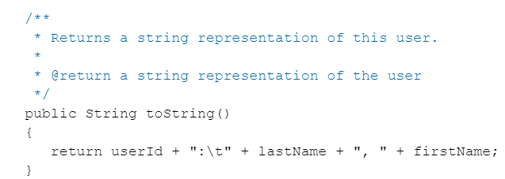
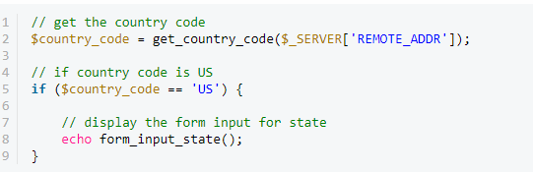
https://code.tutsplus.com/tutorials/top-15-best-practices-for-writing-super-readable-code--net-8118
1. Avoid Obvious Comments

Slide 14
Top best practices (and chapter 2)
1. Name things well
Name app something like consoleUI not just ConsoleApp8
Make solution name different and descriptive
Observe Standard Naming format (E.g., camelCase
https://www.quora.com/How-important-is-naming-things-well-in-software-development
Classes for reuse utility purpose are called nameLibrary
Why? When add reference … you usually look to add libraries
“Possibly the most important part: if you expect to have someone else understand your code or to remember yourself what it does a few days, weeks, or years later, descriptive names are necessary”
Chances are good if you are using the wrong name for something it is not because naming is hard (I agree that it is hard though) but because you actually don’t understand it.

Slide 15
Clean Code: Meaningful names
Names of the classes, variables, and methods must be meaningful and clearly indicate what a method does or what an attribute is.
Create pronounceable names to facilitate communication.
Avoid acronyms and avoid confusing names, which may bring anyone who reads the code to the wrong conclusions.
Use names that reflect the system domain, the context, and the problems that must be solved.

Slide 16
For example
What does my Function do?
Char myFunc(char c){
If (c > 97 && c < 122) return c - 32;
Else return c;
}
How about this way?
Char convertToUpperCase(char c) {
// ascii 97-122 are Lower Case letters
If (c > 97 && c < 122)
return c - 32;
Else return c;
}

Slide 17
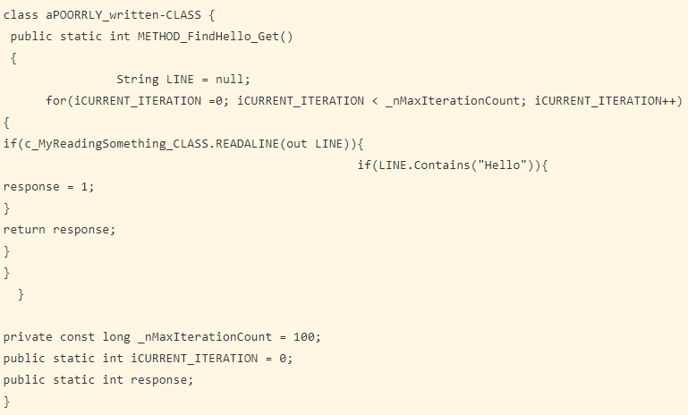
Do not mix naming conventions
And indentation

Slide 18
For example … what is the purpose of this code?
The code is not hard but it not explicit!
The problem is the code’s implicitly (not explicity)
public List<int[]> getThem() { List<int[]> list1 = new ArrayList<int[]>(); for (int[] x : theList) if (x[0] == 4) list1.add(x); return list1; }
Four things that is not obvious from this code….
1. What kinds of things are in theList?
2. What is the significance of the zeroth subscript of an item in theList?
3. What is the significance of the value 4?
4. How would I use the list being returned?

Slide 19
Better naming makes the code more explicit
Say … this is a minesweeper game
Rename theList to gameBoard
public List<int[]> getFlaggedCells() { List<int[]> flaggedCells = new ArrayList<int[]>(); for (int[] cell : gameBoard) if (cell[STATUS_VALUE] == FLAGGED) flaggedCells.add(cell); return flaggedCells; }
Say … we also find a status of 4 means FLAGGED
Not returning theList but flaggedCells

Slide 20
Avoid disinformation ….
avoid leaving false clues that obscure the meaning of code
E.g., The term List has a specific meaning to developers
- do NOT refer to a grouping of accounts as an accountList unless it’s actually a List
instead might use accountGroup
In 1 module use … XYZControllerForEfficientHandlingOfStrings
In Another module XYZControllerForEfficientStorageOfStrings
Why in the world would you do this …
int a = l; if ( O == l ) a = O1; else l = 01;

Slide 21
Use pronounceable names
Suppose to mean …
generation date, year, month, day, hour, minute, and second
Does it mean: “gen-yah-muddahims” ?
class DtaRcrd102 { private Date genymdhms; private Date modymdhms; private final String pszqint = ”102”; /* … */ };
Seriously? What does this mean?
class Customer { private Date generationTimestamp; private Date modificationTimestamp;; private final String recordId = ”102”; /* … */ };
A third party can look at this and have an idea of that it means

Slide 22
The about the name’s search ability ….
Much better
MAX_CLASSES_PER_STUDENT
Use of numbers (like 7) is not searchable
The name e is a poor choice for any variable for which a programmer might need to search
for (int j=0; j<34; j++) { s += (t[j]*4)/5; }
Which would you rather try to understand?
int realDaysPerIdealDay = 4; const int WORK_DAYS_PER_WEEK = 5; int sum = 0; for (int j=0; j < NUMBER_OF_TASKS; j++) { int realTaskDays = taskEstimate[j] * realDaysPerIdealDay; int realTaskWeeks = (realdays / WORK_DAYS_PER_WEEK); sum += realTaskWeeks; }

Slide 23
package christmas_in_july; // WarGame public class DeckaCards { int Suit; int cardNumbuh; String PlayerSelect; int winsNumbuhs; public int getsucc() { return Suit; } public void setsucc(int suit) { this.Suit = suit; } public int getcacc() { return cardNumbuh; } public void setcacc(int cardNumbuh) { this.cardNumbuh = cardNumbuh; } public String getpacc() { return PlayerSelect; } public void setpacc(String playerselect) { PlayerSelect = playerselect; } public int getnacc() { return winsNumbuhs; } public void setnacc(int winsnumbuhs) { this.winsNumbuhs = winsnumbuhs; } public String getCardio() { if (cardNumbuh == 1 ) return "Ace"; else if ( cardNumbuh >=2 && cardNumbuh <= 10 ) return String.valueOf(cardNumbuh); else if ( cardNumbuh == 11 ) return "jack"; else if (cardNumbuh == 12 ) return "queen"; else return "king"; } public String getcaccsacc() { String s = "spades"; if (Suit == 1 ) s = "spades"; else if ( Suit == 2 ) s = "clubs"; else if (Suit == 3 ) s = "diamonds"; else s = "hearts"; return s; } }
Don’t be cute … Think I am kidding?…
Actual code from CSC1700 homework 5

Slide 24
Don’t be cute … or pun Our goal, as authors, is to make our code as easy as possible to understand. We want our code to be a quick skim, not an intense study
public static void main(String[] args) { int a = 0; int b = 0; int c = 0; int d = 0; DeckaCards p1 = new DeckaCards(); p1.setpacc("jack"); p1.setnacc(a); DeckaCards p2 = new DeckaCards(); p2.setpacc("jill"); p2.setnacc(b); Random spork = new Random(); int n = spork.nextInt(13) + 1; int s = spork.nextInt(4) + 1; System.out.printf("ayo p1: jeck and p2: jill to war. fight to die.\n"); for(int i = 0; i<5; i++) { p1.setcacc(n); p1.setsucc(s); System.out.printf("\njeck got a %s of %s", p1.getCardio(), p1.getcaccsacc()); n = spork.nextInt(13) + 1; s = spork.nextInt(4) + 1; p2.setcacc(n); p2.setsucc(s); System.out.printf("\njill got a %s of %s", p2.getCardio(), p2.getcaccsacc()); if (p1.cardNumbuh > p2.cardNumbuh || p1.cardNumbuh == 1 && p2.cardNumbuh != 1) { System.out.printf("\njeck won the thing"); a++; p1.setnacc(a); if(p2.winsNumbuhs == 0){ System.out.printf("\njeck has won a single time\n"); } else System.out.printf("\njeck has %s wins and jill has %s wins\n", p1.winsNumbuhs, p2.winsNumbuhs); } else if (p1.cardNumbuh < p2.cardNumbuh || p2.cardNumbuh == 1 && p1.cardNumbuh !=1) { System.out.printf("\njill won the thing"); b++; p2.setnacc(b); if(p1.winsNumbuhs ==0) { System.out.printf("\njill has a single win\n"); } else System.out.printf("\njill has %s wins and jeck has %s wins\n", p2.winsNumbuhs, p1.winsNumbuhs); } else { d++; System.out.printf("\nthey both die.\n"); } c++; if(c == 1) { System.out.printf("\nwe played a single game of war\n"); } else System.out.printf("\nwe have played war %s times\n", c); } if(p1.winsNumbuhs == 0) { System.out.printf("\nthe game is now finished.\n" ); if(d == 0 ) { System.out.printf("\njill has asserted her dominance on this plane of existence. she won all %s times", p2.winsNumbuhs); } else if (d==1) System.out.printf("jeck should be ashamed of himself with his no wins. jill won %s times and has comitted 1 draw.", p2.winsNumbuhs); else System.out.printf("jeck won no times at all, but jill has won %s times with %s draws.", p2.winsNumbuhs, d); } else if(p2.winsNumbuhs == 0) { System.out.printf("\nthe game is now finished.\n" ); if(d == 0 ) { System.out.printf("\njeck has asserted his dominance on this plane of existence. he won all %s times", p1.winsNumbuhs); } else if (d==1) System.out.printf("jill should be ashamed of herself with her no wins. jeck won %s times and has comitted 1 draw.", p1.winsNumbuhs); else System.out.printf("jill won no times at all, but jeck has won %s times with %s draws.", p1.winsNumbuhs, d); } else if(d==0) System.out.printf("\nthe game is now over. jeck has %s wins, jill has %s wins", p1.winsNumbuhs,p2.winsNumbuhs); else if(d==1) System.out.printf("\nthe game is now over. jeck has %s wins, jill has %s wins, and they have a single draw", p1.winsNumbuhs,p2.winsNumbuhs); else if (d==5) { System.out.printf("\neveryone loses. no one lives at all with %s draws", d); } else System.out.printf("\nthe game is now over. jeck has %s wins, jill has %s wins, and they have %s draws", p1.winsNumbuhs, p2.winsNumbuhs, d); } }

Slide 25
The problem with names ….
Good names require …
Good descriptive skills
Shared cultural background
Often times … afraid of renaming things during refactoring…. If its clearer and the developer is professional they will often appreciate it.

Slide 26
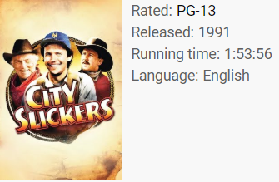
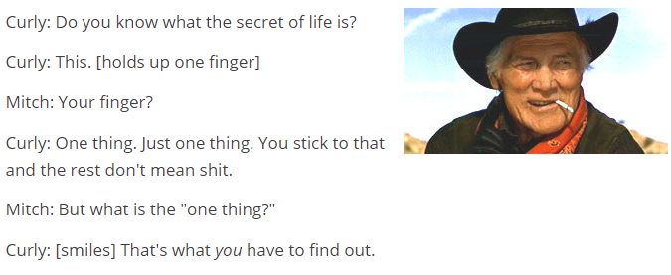
Chapter 3 – Functions, Methods
https://www.youtube.com/watch?v=-1bTe54j6PQ 3:14
Jack Palance and Billy Crystal discuss the meaning of life. Simple...not easy, but simple.
Academy Awards, USA 1992. Winner Oscar, Best Actor in a Supporting Role Jack Palance. Golden Globes, USA 1992
FUNCTIONS SHOULD DO ONE THING. THEY SHOULD DO IT WELL. THEY SHOULD DO IT ONLY.
How this happens ….
something is always being added to a method but nothing is ever taken out.

Slide 27
public static String testableHtml( PageData pageData, boolean includeSuiteSetup ) throws Exception { WikiPage wikiPage = pageData.getWikiPage(); StringBuffer buffer = new StringBuffer(); if (pageData.hasAttribute("Test")) { if (includeSuiteSetup) { WikiPage suiteSetup = PageCrawlerImpl.getInheritedPage( SuiteResponder.SUITE_SETUP_NAME, wikiPage ); if (suiteSetup != null) { WikiPagePath pagePath = suiteSetup.getPageCrawler().getFullPath(suiteSetup); String pagePathName = PathParser.render(pagePath); buffer.append("!include -setup .") .append(pagePathName) .append("\n"); } } WikiPage setup = PageCrawlerImpl.getInheritedPage("SetUp", wikiPage); if (setup != null) { WikiPagePath setupPath = wikiPage.getPageCrawler().getFullPath(setup); String setupPathName = PathParser.render(setupPath); buffer.append("!include -setup .") .append(setupPathName) .append("\n"); } } buffer.append(pageData.getContent()); if (pageData.hasAttribute("Test")) { WikiPage teardown = PageCrawlerImpl.getInheritedPage("TearDown", wikiPage); if (teardown != null) { WikiPagePath tearDownPath = wikiPage.getPageCrawler().getFullPath(teardown); String tearDownPathName = PathParser.render(tearDownPath); buffer.append("\n") .append("!include -teardown .") .append(tearDownPathName) .append("\n"); } if (includeSuiteSetup) { WikiPage suiteTeardown = PageCrawlerImpl.getInheritedPage( SuiteResponder.SUITE_TEARDOWN_NAME, wikiPage ); if (suiteTeardown != null) { WikiPagePath pagePath = suiteTeardown.getPageCrawler().getFullPath (suiteTeardown); String pagePathName = PathParser.render(pagePath); buffer.append("!include -teardown .") .append(pagePathName) .append("\n"); } } } pageData.setContent(buffer.toString()); return pageData.getHtml(); }
Code from 1. An open-source testing tool. www.fitnesse.org
how much sense you can make of it in the next three minutes
The length should not be measured in LOC, but in the amount of time required to comprehend precisely what it does. And that length, should be no more than a minute. If I can't figure it out in a few seconds, it's probably doing too much...after a minute, it definitely is.

Slide 28
Consider this refactoring …
this function performs the inclusion of some setup and teardown pages into a test page and then renders that page into HTML
public static String renderPageWithSetupsAndTeardowns( PageData pageData, boolean isSuite ) throws Exception { boolean isTestPage = pageData.hasAttribute("Test"); if (isTestPage) { WikiPage testPage = pageData.getWikiPage(); StringBuffer newPageContent = new StringBuffer(); includeSetupPages(testPage, newPageContent, isSuite); newPageContent.append(pageData.getContent()); includeTeardownPages(testPage, newPageContent, isSuite); pageData.setContent(newPageContent.toString()); } return pageData.getHtml(); }

Slide 29
Functions (and classes) should be small
The first rule of functions is that they should be small.
The second rule of functions is that they should be smaller than that
in the 80s – Rule of thumb => function should be no bigger than a screen-full
(VT100 screens were 24 lines by 80 columns)
public static String renderPageWithSetupsAndTeardowns( PageData pageData, boolean isSuite) throws Exception { if (isTestPage(pageData)) includeSetupAndTeardownPages(pageData, isSuite); return pageData.getHtml(); }

Slide 30
Proper Arguments
Passing a boolean into a function is a truly terrible practice.
It proclaims function does > 1 thing
Best case -> 0, 1 acceptable, >2 need justification
Arguments increase complexity of
understanding
Testing
Debugging
significantly harder to understand
It will return true if: expected.equals( actual ) returns true
Junit assertEquals
assertEquals(expected, actual)
assertEquals(message, expected, actual)
You can have assertion method with an additional String parameter as the first parameter. This string will be appended in the failure message if the assertion fails. E.g. fail( message ) can be written as
Consider using an object when need to pass > 2 arguments.
The second below is more descriptive
Circle makeCircle(double x, double y, double radius); Circle makeCircle(Point center, double radius);

Slide 31
Methods should not have side effects …
No hidden things
Name is user Validator
public class UserValidator { private Cryptographer cryptographer; public boolean checkPassword(String userName, String password) { User user = UserGateway.findByName(userName); if (user != User.NULL) { String codedPhrase = user. getPhraseEncodedByPassword(); String phrase = cryptographer.decrypt(codedPhrase, password); if ("Valid Password".equals(phrase)) { Session.initialize(); return true; } } return false; } }
side effect is the call to Session.initialize()
The name does not imply that it initializes the session

Slide 32
DRY Principle – Don’t Repeat YourSelf
https://en.wikipedia.org/wiki/Don%27t_repeat_yourself
"Every piece of knowledge must have a single, unambiguous, authoritative representation within a system
Dave Thomas, Andrew Hunt “The Pragmatic Programmer”
https://en.wikipedia.org/wiki/The_Pragmatic_Programmer
To avoid violating the DRY principle
- divide code and logic into smaller reusable units
- and use that code by calling it where you want.
No lengthy methods, but smaller and reusable.
E.g., A shipment class => basic business model of company
Suppose business logic in lots of places
Change: ship to 5 instead of 1 warehouse
Better: Isolate the how shipments work in 1 place
Can be business object or algorithm (e.g., B-tree implementation) or data structurer

Slide 33
Example1: Is this a DRY violation?
<?php
interface Product {
public function displayPrice();
}
class PlasticDuck implements Product {
/** @var int */
private $price;
public function __construct(int $price)
{
$this->price = $price;
}
public function displayPrice()
{
echo sprintf("The price of this plastic duck is %d euros!", $this->price);
}
}
$plasticDuck = new PlasticDuck(2);
$plasticDuck->displayPrice();
Is this code a DRY violation? Price is use repeated and
Here and
And here

Slide 34
Example 2: DRY violation?
Are if statements too spread out? Couldn’t this code be tighter?
<?php
class CsvValidation
{
public function validateProduct(array $product)
{
if (!isset($product['color'])) {
throw new \Exception('Import fail: the product attribute color is missing');
}
if (!isset($product['size'])) {
throw new \Exception('Import fail: the product attribute size is missing');
}
if (!isset($product['type'])) {
throw new \Exception('Import fail: the product attribute type is missing');
}
}
}

Slide 35
Example 2: A better implementation but previous code was not DRY violation
class CsvValidation
{
private $productAttributes = [
'color',
'size',
'type',
];
public function validateProduct(array $product)
{
foreach ($this->productAttributes as $attribute) {
if (!isset($product[$attribute])) {
throw new \Exception(sprintf('Import fail: the product attribute %s is missing', $attribute));
}
}
}
}
To summarize:
Knowledge duplication is always a DRY principle violation
Code duplication doesn’t necessarily mean violation of the DRY principle.

Slide 36
Example 3: DRY violation?
Here can see 2 classes
1 implements logic about shipments
Another shipment returns
?
<?php
/** Shipment from the warehouse to the customer */
class Shipment
{
public $deliveryTime = 4; //in days
public function calculateDeliveryDay(): DateTime
{
return new \DateTime("now +{$this->deliveryTime} day");
}
}
/** Order return of a customer */
class OrderReturn
{
public $returnLimit = 4; //in days
public function calculateLastReturnDay(): DateTime
{
return new \DateTime("now +{$this->returnLimit} day");
}
}
the delivery time of a shipment to a customer (Shipment::calculateDeliveryDay()) has nothing to do with the last day the customer can return his ordered products (Return::calculateLastReturnDay).
These are two different functionalities. What appears to be a code duplication is just a pure coincidence

Slide 37
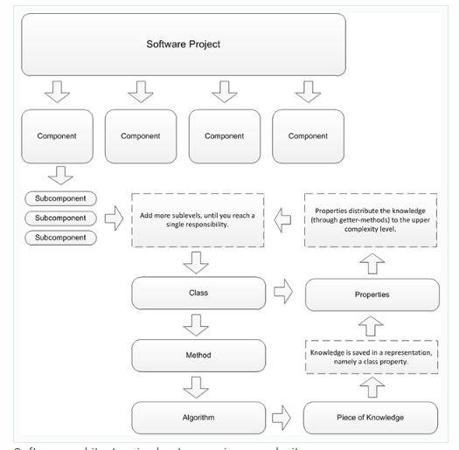
Dave Thomas: “A system’s knowledge is far broader than just its code. It refers to database schemas, test plans, the build system, even documentation.”
you shouldn’t need to update in parallel multiple things when one change occurs.
For example, building a CMS
1 component => user management will be a component.
- user management can be divided into subcomponents,
(like role management) and it may communicate with other components, e.g, security
divide systems into components => complexity is reduced to a single responsibility.
Classes implement the responsibilities.
Methods implement algorithms.
DRY is a philosophy that packages logic into representations. DRY and modular architecture require good planning

Slide 38
DRY is a philosophy that packages logic into representations. DRY and modular architecture require good planning
A few rules for achieve DRY architecture:
Draw application’s visual hierarchy.
Map the main components to it. (might use UML)
2. Before coding module => name its hierarchy in your software project and define what it's representing.
3. Define the representation’s Ins and Outs – What it exposes to other parties (like functions to execute SQL in a database driver) and what it hides (like the database credentials).
4. Ensure that representations do not rely on representations of another complexity level (like a component that relies on a class in another component).

Slide 39
CSC3610 Assignment – Connect to DB, query
package in_classwork_homework; import java.io.*; import java.sql.*; import java.util.*; public class DBAbstract { private Connection connection; private int numQueries; private String DBName; private String PWFilePath; private String PassW; private String UserId; DBAbstract(String DBName, String PWFilePath) { this.DBName = DBName; this.PWFilePath = PWFilePath; this.setPW(PWFilePath); this.setConnect(); } private void setConnect() { try { String dbInfo = "jdbc:mysql://" + this.DBName; connection = DriverManager.getConnection(dbInfo, this.UserId, this.PassW); } catch (SQLException e) { e.printStackTrace(); } } public ResultSet doQuery(String SQL) throws SQLException { Statement statement = connection.createStatement(); ResultSet resultSet = statement.executeQuery(SQL); return resultSet; } public void setPW(String fName) { File file = new File(fName); try { Scanner scnr = new Scanner(file); int lineNumber = 1; this.UserId = scnr.nextLine(); this.PassW = scnr.nextLine(); while (scnr.hasNextLine()) { String line = scnr.nextLine(); System.out.println("line " + lineNumber + " :" + line); lineNumber++; } scnr.close(); } catch (Exception e) { System.out.println(e); } } }
Assignment … connect to DB … extract all the records from a table
Load the data into an arrayList, HashMap and TreeMap …
time the difference
DB Connection code … provided to student

Slide 40
package in_classwork_homework; public class EmployeeList implements Comparable<EmployeeList>{ int emp_no; String birth_date; String first_name; String last_name; String gender; String hire_date; EmployeeList(String id, String bd, String fn, String ln, String g, String hd) { emp_no = Integer.parseInt(id); birth_date = bd; first_name = fn; last_name = ln; gender = g; hire_date = hd; } public void printInfo() { System.out.printf("ID number: %d\nName: %s\nGender: %s\nDate of Birth: %s\nDate Hired: %s\n", emp_no, (first_name + " " + last_name), gender, birth_date, hire_date); } public int getEmp_no() { return emp_no; } public void setEmp_no(int emp_no) { this.emp_no = emp_no; } public String getBirth_date() { return birth_date; } public void setBirth_date(String birth_date) { this.birth_date = birth_date; } public String getFirst_name() { return first_name; } public void setFirst_name(String first_name) { this.first_name = first_name; } public String getLast_name() { return last_name; } public void setLast_name(String last_name) { this.last_name = last_name; } public String getGender() { return gender; } public void setGender(String gender) { this.gender = gender; } public String getHire_date() { return hire_date; } public void setHire_date(String hire_date) { this.hire_date = hire_date; } public int compareTo(EmployeeList e) { if (this.emp_no == e.getEmp_no()) { return 0; } else if (this.emp_no < e.getEmp_no()) { return -1; } else { return 1; } } }
Student built a nice class to hold employee info

Slide 41
package in_classwork_homework; import java.sql.*; import java.util.*; public class DriveDB { public static void main(String[] args) { String DBPath = "45.55.136.114/csc3610"; String fName = "C:\\Users\\StudentsDriveName\\Desktop\\CSC3610\\DB\\src\\pw.txt"; DBAbstract DB = new DBAbstract(DBPath, fName); String SQL = "select emp_no, birth_date, first_name, last_name, gender, hire_date from employees limit 10"; ResultSet resultSet; System.out.println("Employee Info:\n"); final long ALstart = System.currentTimeMillis(); ArrayList<EmployeeList> ALemployees = new ArrayList<EmployeeList>(); try { resultSet = DB.doQuery(SQL); while (resultSet.next()) ALemployees.add(new EmployeeList(resultSet.getString(1), resultSet.getString(2), resultSet.getString(3), resultSet.getString(4), resultSet.getString(5), resultSet.getString(6))); } catch (SQLException e) { System.out.printf("\nSQL Failed=%s", SQL); e.printStackTrace(); } System.out.println("ArrayList:\n"); for (EmployeeList e : ALemployees) { e.printInfo(); System.out.println(); } final long ALend = System.currentTimeMillis(); final double ALtime = (ALend - ALstart) / 1000.0; System.out.printf("Processing with ArrayList took %.2f seconds.\n", ALtime); final long HSstart = System.currentTimeMillis(); HashSet<EmployeeList> HSemployees = new HashSet<EmployeeList>(); try { resultSet = DB.doQuery(SQL); while (resultSet.next()) HSemployees.add(new EmployeeList(resultSet.getString(1), resultSet.getString(2), resultSet.getString(3), resultSet.getString(4), resultSet.getString(5), resultSet.getString(6))); } catch (SQLException e) { System.out.printf("\nSQL Failed=%s", SQL); e.printStackTrace(); } System.out.println("\nHashSet:\n"); for (EmployeeList e : HSemployees) { e.printInfo(); System.out.println(); } final long HSend = System.currentTimeMillis(); final double HStime = (HSend - HSstart) / 1000.0; System.out.printf("Processing with HashSet took %.2f seconds.\n", HStime); final long LHSstart = System.currentTimeMillis(); LinkedHashSet<EmployeeList> LHSemployees = new LinkedHashSet<EmployeeList>(); try { resultSet = DB.doQuery(SQL); while (resultSet.next()) LHSemployees.add(new EmployeeList(resultSet.getString(1), resultSet.getString(2), resultSet.getString(3), resultSet.getString(4), resultSet.getString(5), resultSet.getString(6))); } catch (SQLException e) { System.out.printf("\nSQL Failed=%s", SQL); e.printStackTrace(); } System.out.println("\nLinkedHashSet:\n"); for (EmployeeList e : LHSemployees) { e.printInfo(); System.out.println(); } final long LHSend = System.currentTimeMillis(); final double LHStime = (LHSend - LHSstart) / 1000.0; System.out.printf("Processing with LinkedHashSet took %.2f seconds.\n", LHStime); final long TSstart = System.currentTimeMillis(); TreeSet<EmployeeList> TSemployees = new TreeSet<EmployeeList>(); try { resultSet = DB.doQuery(SQL); while (resultSet.next()) TSemployees.add(new EmployeeList(resultSet.getString(1), resultSet.getString(2), resultSet.getString(3), resultSet.getString(4), resultSet.getString(5), resultSet.getString(6))); } catch (SQLException e) { System.out.printf("\nSQL Failed=%s", SQL); e.printStackTrace(); } System.out.println("\nTreeSet:\n"); for (EmployeeList e : TSemployees) { e.printInfo(); System.out.println(); } final long TSend = System.currentTimeMillis(); final double TStime = (TSend - TSstart) / 1000.0; System.out.printf("Processing with TreeSet took %.2f seconds.", TStime); } }
Student drive code submitted … comments? Is it DRY? How will you fix it?

Slide 42
1972 -> Dijkstra on Structured Programming
every function, and every block within a function, should have one entry and one exit.
Following these rules means that there should only be one return statement in a function, no break or continue statements in a loop, and never, ever, any goto statements.
functions small => No problem => occasional multiple return, break, or continue statement
[SP72]: Structured Programming, O.-J. Dahl, E. W. Dijkstra, C. A. R. Hoare, Academic Press, London, 1972.

Slide 43
In Summary
In a system:
Classes are the nouns
Functions are the verbs
Writing software is like writing a story
- Need to get ideas down first then massage it until it reads well
- First draft might be disorganized and then need to work on it
First attempts often need work… need reworking until come out small and organized

